Slide 1
Employee Data Analysis using Excel
STUDENT NAME: VELUKKANNAN A M M
REGISTER NO: 312201217
NAAN MUDHALAVAN USERNAME:asunm110312201217
NAAN MUDHALVAN ID:DB1F3EFDABEA2879FD144B5D48E290D3
DEPARTMENT: B.COM BANK MANAGEMENT
COLLEGE: DRBCCC HINDU COLLEGE

Slide 2
PROJECT TITLE EMPLOYEE PAY ANALYSIS USING EXECEL

Slide 3

AGENDA
Problem Statement
Project Overview
End Users
Our Solution and Proposition
Dataset Description
Modelling Approach
Results and Discussion
Conclusion

Slide 4

PROBLEM STATEMENT

Slide 5

PROJECT OVERVIew

Slide 6
WHO ARE THE END USERS?

Slide 7

OUR SOLUTION AND ITS VALUE PROPOSITION

Slide 8
Dataset Description Employee data- edunet dashboard total 9 features from a to h 3 features were taken gender-male female salary-number department-text

Slide 9

THE "WOW" IN OUR SOLUTION
The wow factor in this employee analysis project is that we have been able to find out total salaries received by the employees and we would also specifically able to know what is the salaries received by both male and female department wise in the company
3/21/2024 Annual Review

Slide 10
MODELLING
Data collection
Data cleaning
Filtering of data
Selecting the required fields
Converting them into a pivot table
Summarising the data
Getting the results from the data after arrangement
Getting the bar graph
Doing the data visualization

Slide 11
collect the employee data from edunet dashboard
Clean the data set by using conditional formatting
Filter the data by removing the blank spaces
Select the required fields like (gender,department,salary) are selected here
Now we have to convert the selected data into pivot table
After that we have to arrange the data in rows and coloums and filter and sums
Now we have to go to insert and choose a bar chart to represent the data
After choosing bar graph we can be able to represent our data visually
Last data visualization where the graph will be presented

Slide 12
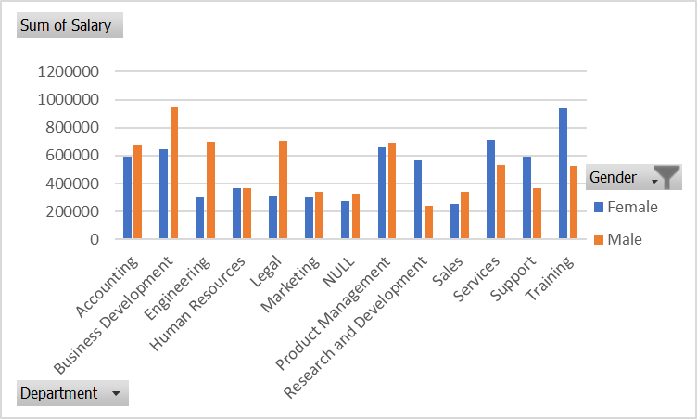
RESULTS
12

Slide 13
Conclusion by this data analysis we can be able to find the salaries received by the employees department wise and we can also be able to see the salary received by the males and females of the company separately in each department so that the company can analyze the pay of employees In the company

